Slide 1

Business analysis

Slide 2
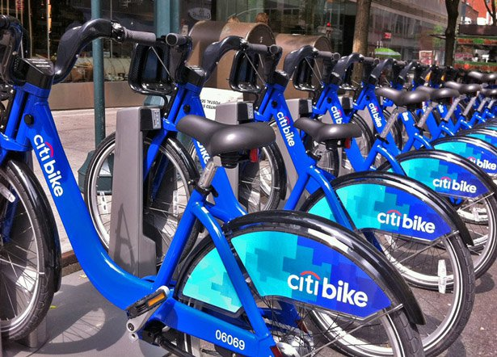
Business Analysis – Q1 2013 to Q1 2014
Marketing Approach
Strategic – and Intelligent
Data

Slide 3
Base Plan
Data
Find our key demographic
Location
Operations
Bikes
Profit
Demographic Targeting
Locations
Effective Operation
Maintenance

Slide 4
DATA

Slide 5
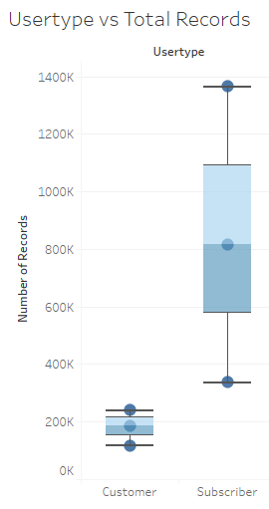
Business Paradigm – Subscriptions vs Customer
Goes without saying Customers mean business.
But this is short term thinking.
Customer analysis has shown ‘subscriber’ users are much more likely and key consumer.

Slide 6
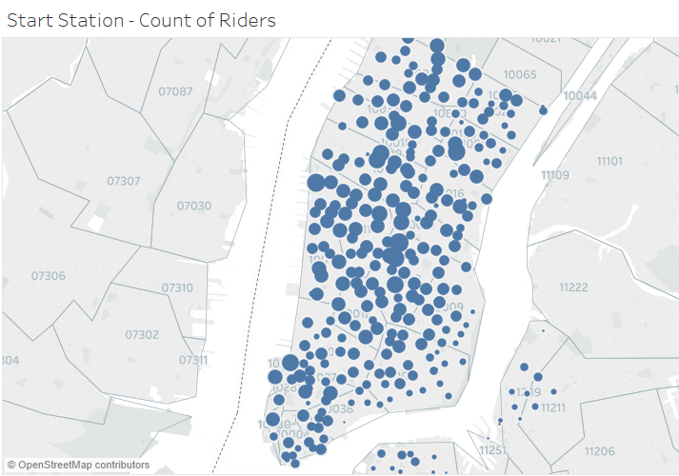
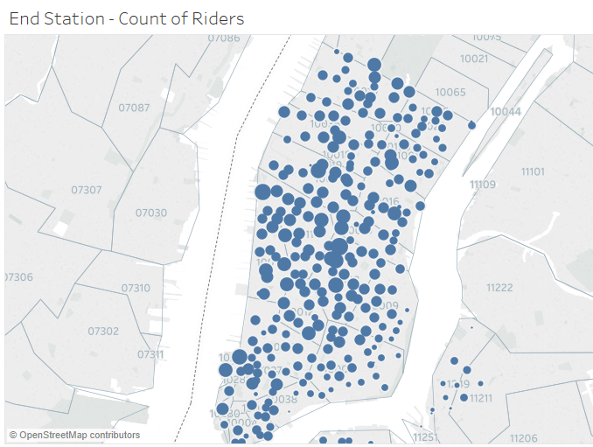
Location
Starting Location and Stop Locations
Determine the number of riders at each location
Break it down by zip codes - precision

Slide 7
Change in Demographics - Daily
Sporadic – gender based analysis is time wasted

Slide 8
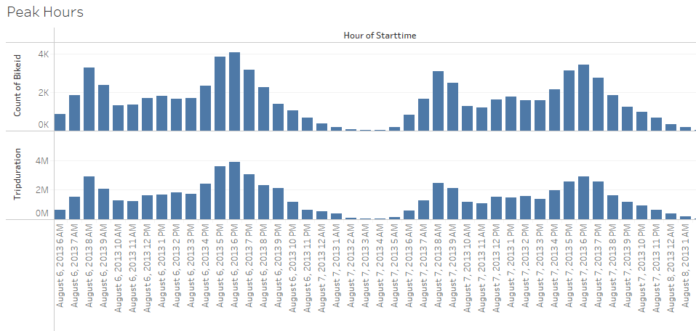
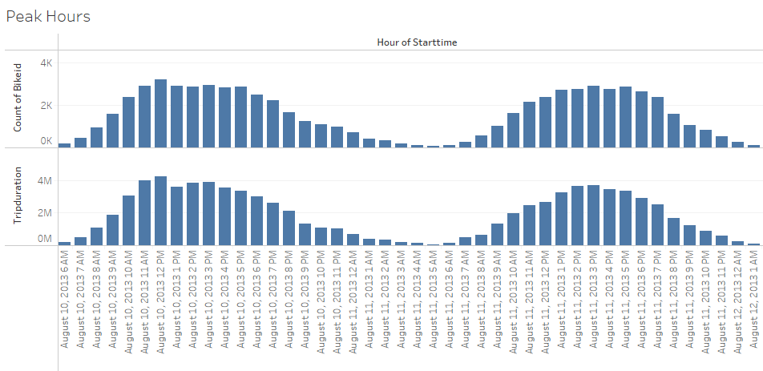
WORK DYNAMICS
Typical WORK DAY
TYPICAL WEEKEND

Slide 9
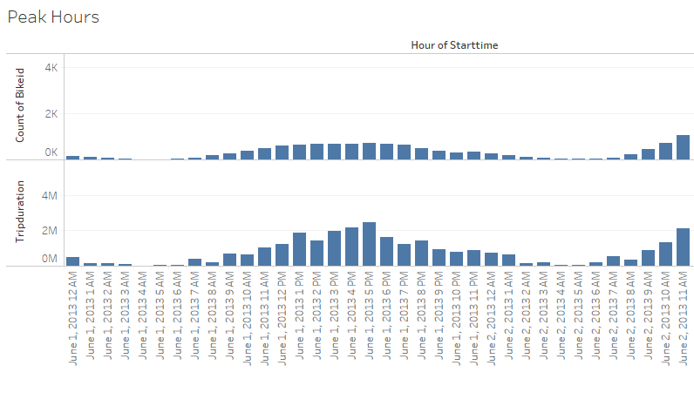
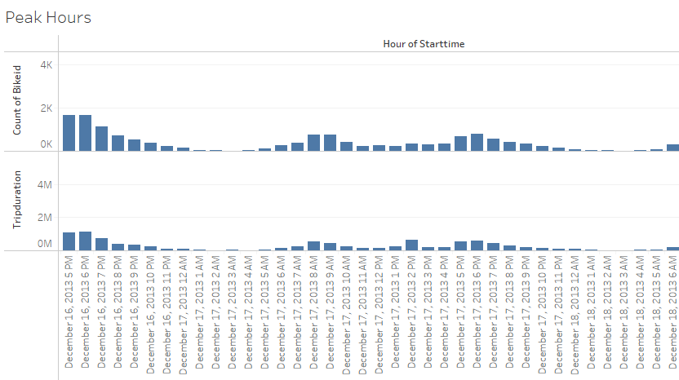
SEASONAL DYNAMICS
Summer
Winter

Slide 10
Marketing Analysis
Subscribers
Weekends
Leisure
Consistent
8am – 9pm
Weekdays
Twin peaks
First peak: 8am
Second peak: 5-6pm
Seasonal
Window of activity
Location
Location of activity
Effective marketing

Slide 11
OPERATION

Slide 12
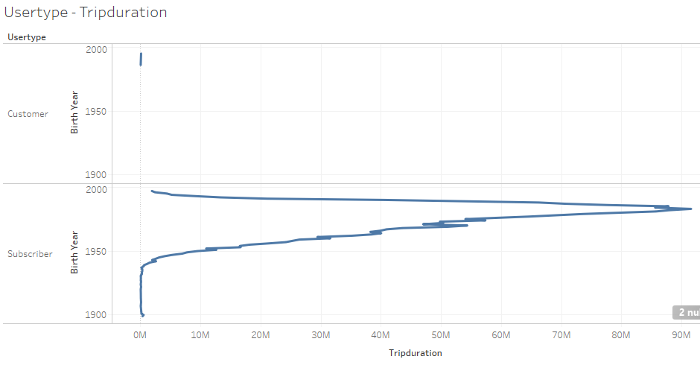
Bicycle Wear

Slide 13
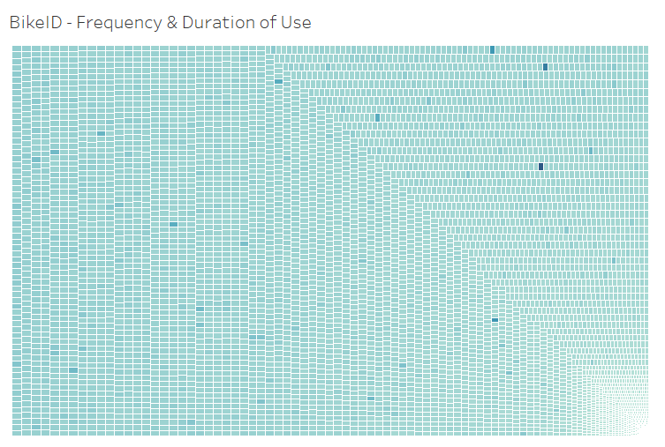
Bicycle Maintenance
Pin-point accuracy we can determine the bike with largest wear.
Determine trip duration associated to it.
Actively monitor and maintenance as needed.

Slide 14
PROFIT

Slide 15
Customer Understanding
Operations Understanding
Subscribers
Weekends vs Weekdays
Seasonal
Location
Duration of Trips
Frequency of Trips
Precise Bike Status

